Slide 1
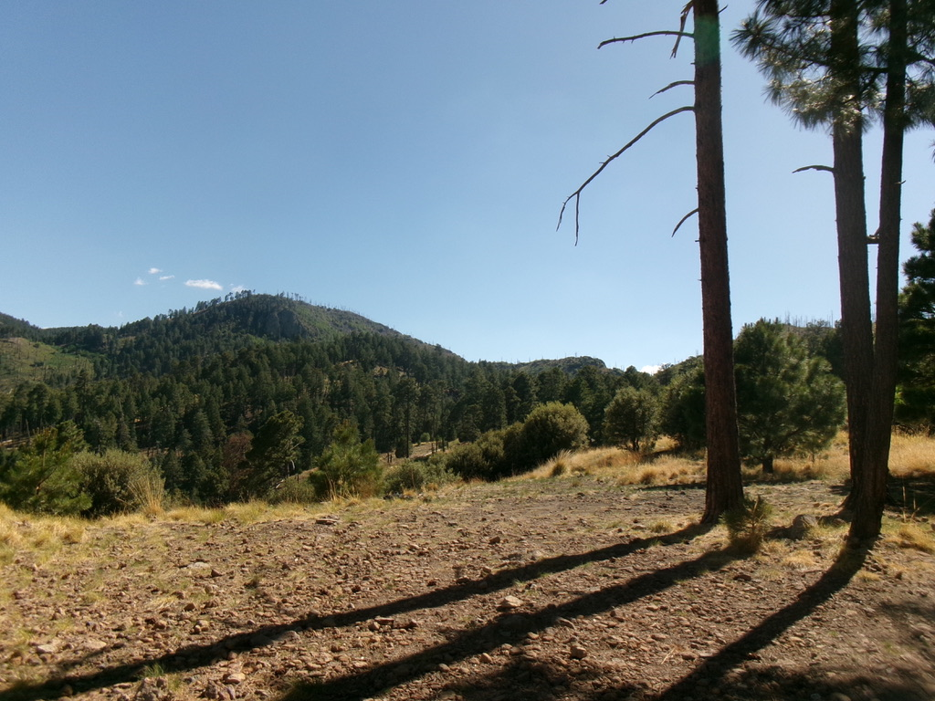

Exploratory analysis of spatial dependence in plant communities
Fern Bromley
Independent Research Project
STAT 574E
October 2025
Notes:
https://cran.r-project.org/web/packages/adespatial/vignettes/tutorial.html#mc
Do an adespatial “tutorial”

Slide 2
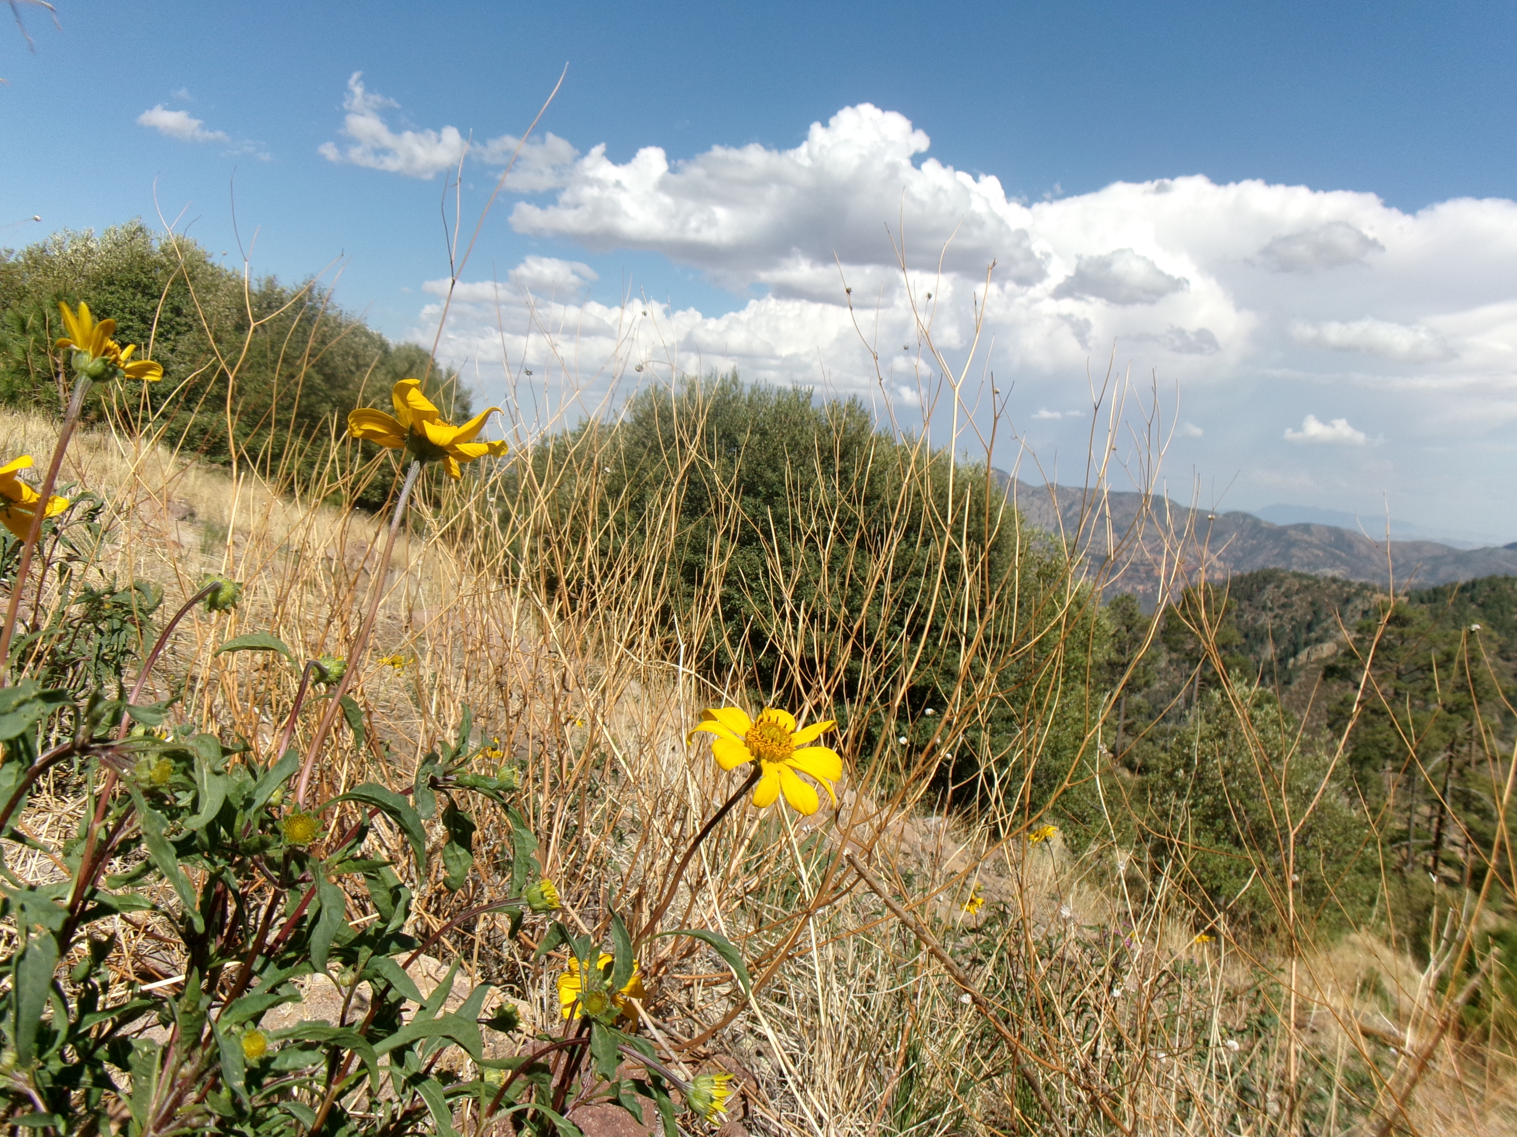
Rough outline
Community ecology methods
Plant communities in a spatial context
Methods for considering spatial structure
Notes:
So what ill be talking about today is a little background on methods in community ecology data, specifically I’ll be talking about plants, but these methods are analogous to any sort of community analysis- which ill define- or any multivariate situation really.
I’ll talk about why it’s important to study plant communities in a spatial context and what information this adds
And I’ll talk about and cover some methods that we can use to estimate spatial dependence.

Slide 3
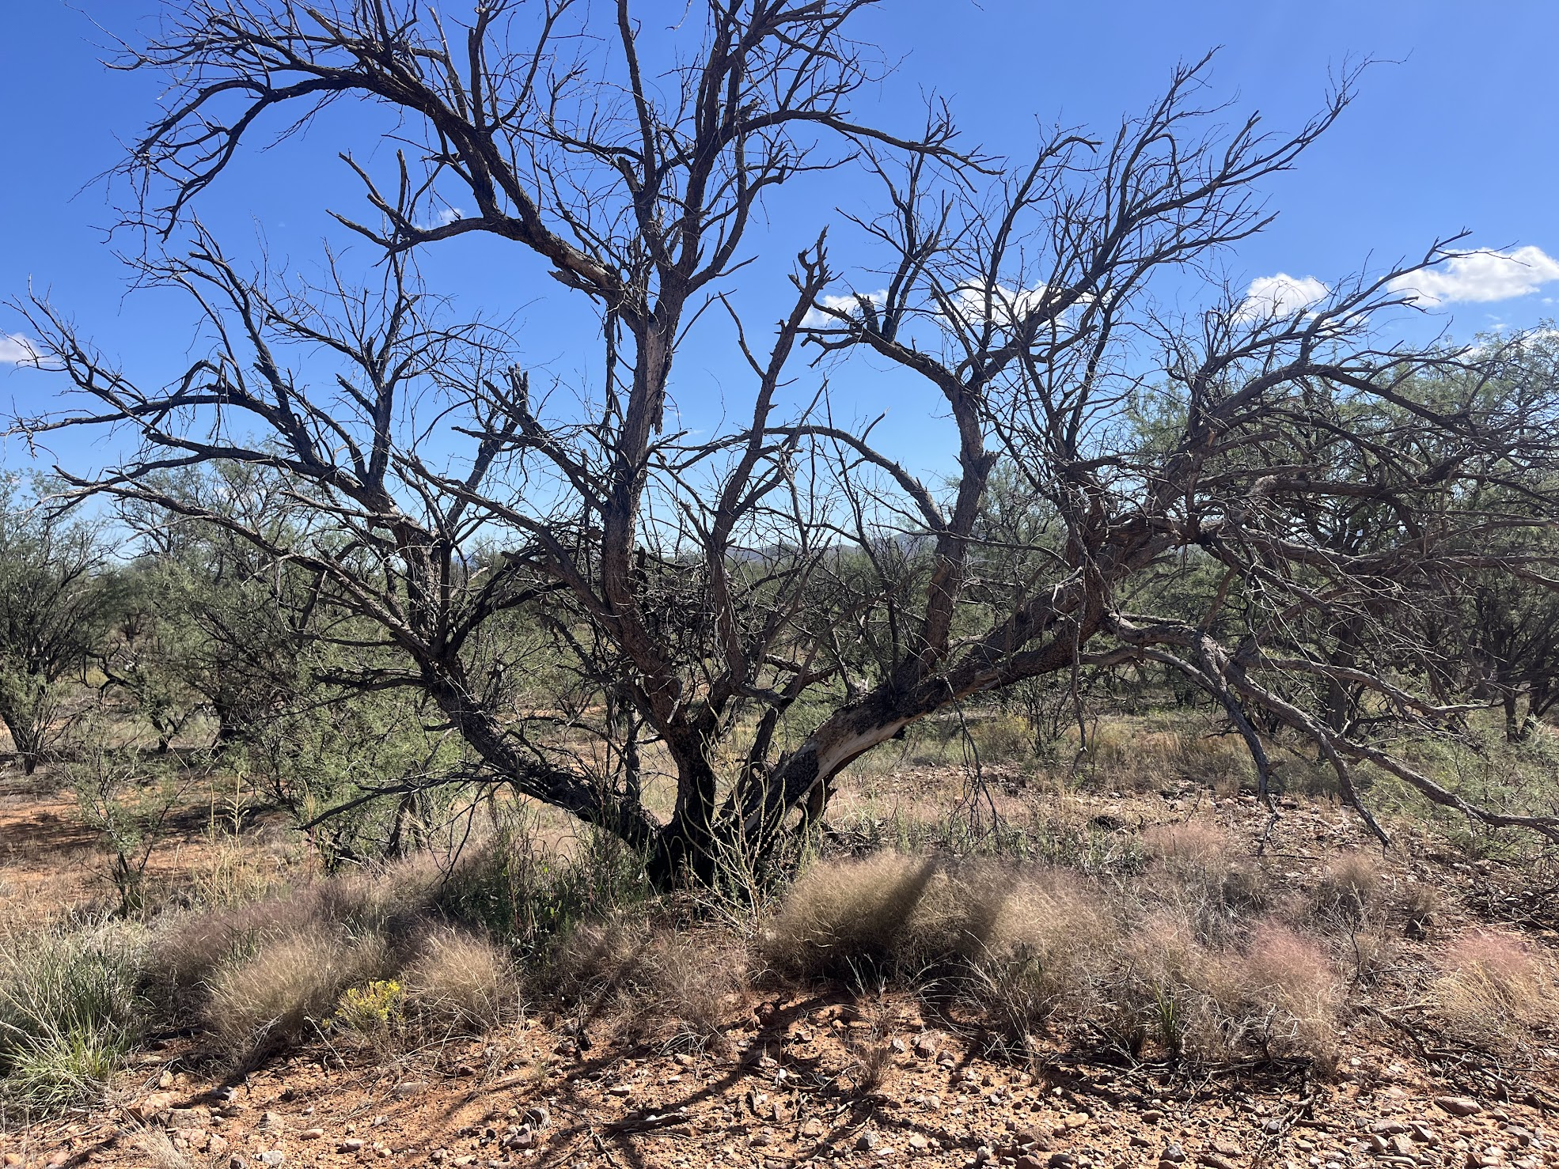
What is a plant community?
Many plant species living in an assemblage within some geographically constrained area
Community composition varies with climate, soil type, land use, disturbance history, and many other physical factors
Notes:
So first, what is a plant community? It is just the set of plant species that are living within a specific geographic area. We can look at plant communities at many scales and there are interactions between species such that we can characterize ecosystems based on dominant species that are often found together,.
Why do we care?
- Describe and predict responses to disturbance
- Understand interspecific interactions (facilitation, competition, exclusion)

Slide 4
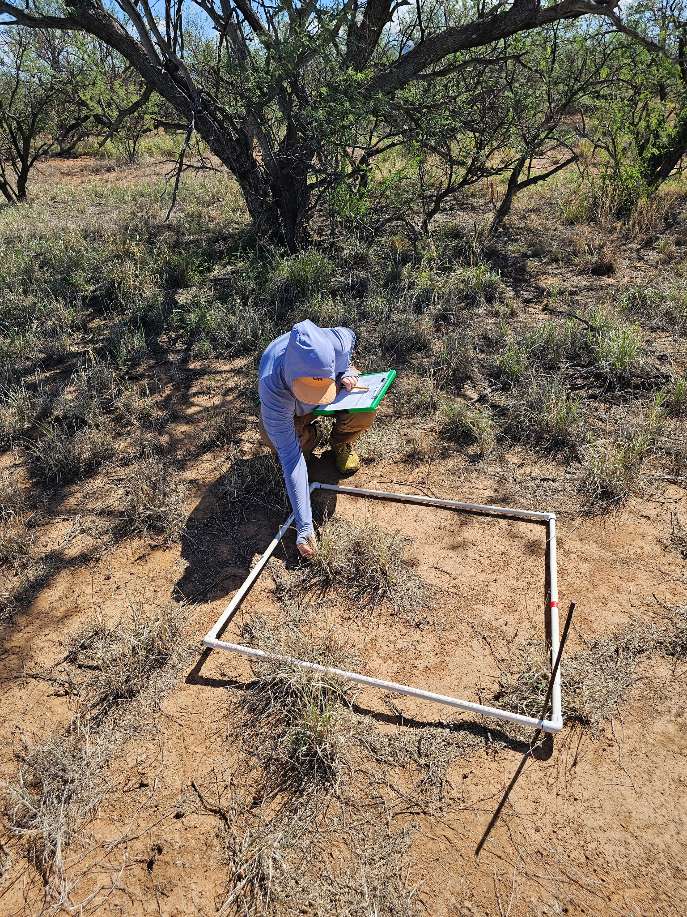
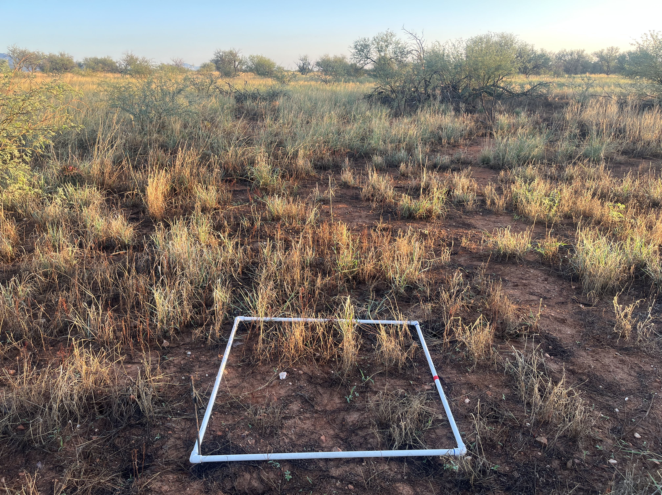

Slide 5



Plant community data are multivariate
Cover values for each species are treated as a variable/dimension of the dataset
Each plot is described in terms of % cover from a larger species pool
Plant communities are usually described by ordinations that consider species presence and abundance
Plot | Palm tree | Tulip | Cactus
Plot 1 | 20 | 20 | 0
Plot 2 | 0 | 0 | 60
Plot 3 | 10 | 0 | 25
Plot n x species n
community matrix
Notes:
I work with datasets termed community matrices where rows are plots, and columns are species. If a species in the overall “species pool”- the set of species from all plots in the dataset- is absent from a plot, then that cell gets a zero- otherwise, if the species is present in a plot, you have the percentage of the plot covered by that species.
To do statistics, we rely on multivariate methods like permutational ANOVAs and we also use ordinations such as principal component analysis, detrended correspondence analysis, and nonmetric multidimensional scaling to visualize differences in communities with reduced dimensionality.

Slide 6
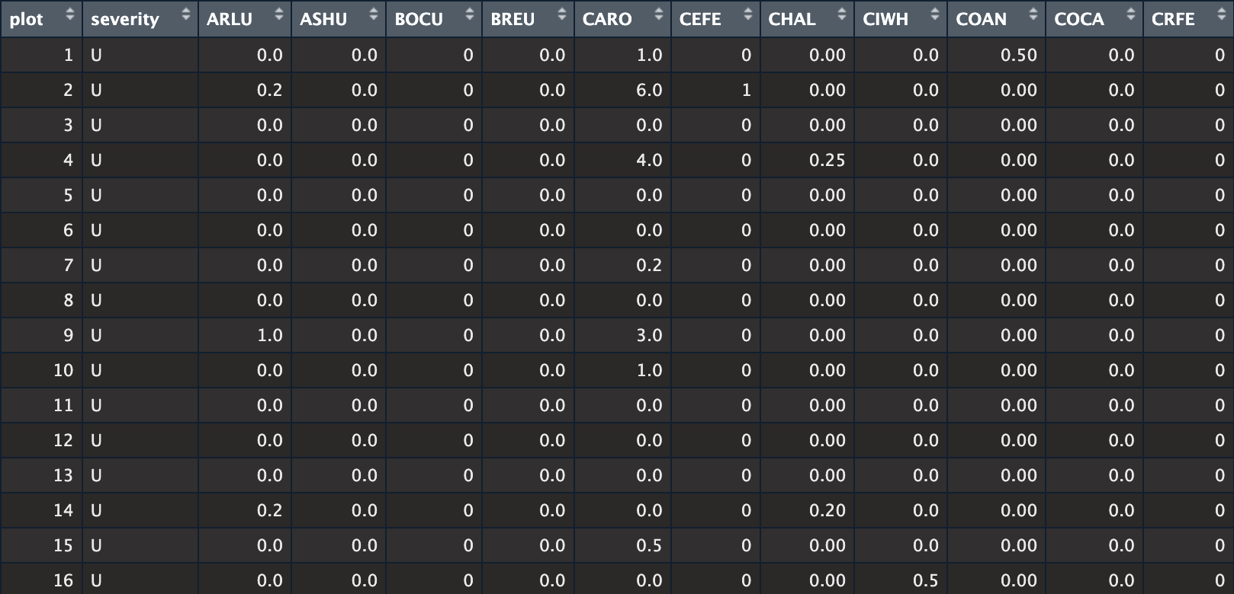
Museum Fire site community matrix
…
57 plots x 42 species
Notes:
I’m going to demonstrate these methods with some data from a mixed-severity fire up in Flagstaff, Arizona collected by my lab-mates that we have been using to assess how this ecosystem is responding to these differences in post-fire conditions. We have our community matrix on the left with those plot rows and species columns, and on the right we have a nonmetric multidimensional scaling or NMDS of these data, and plots have been colored by their wildfire severity. The ellipses are essentially a 95% confidence interval around the centroids of these communities within this 2d ordination space. The arrows with those labels are an additional way to look at differences in communities, such that plots further along the resprouting vector from the origin had more species with the ability to resprout after the fire, and plots further along the height vector tended to have species that grew taller.

Slide 7
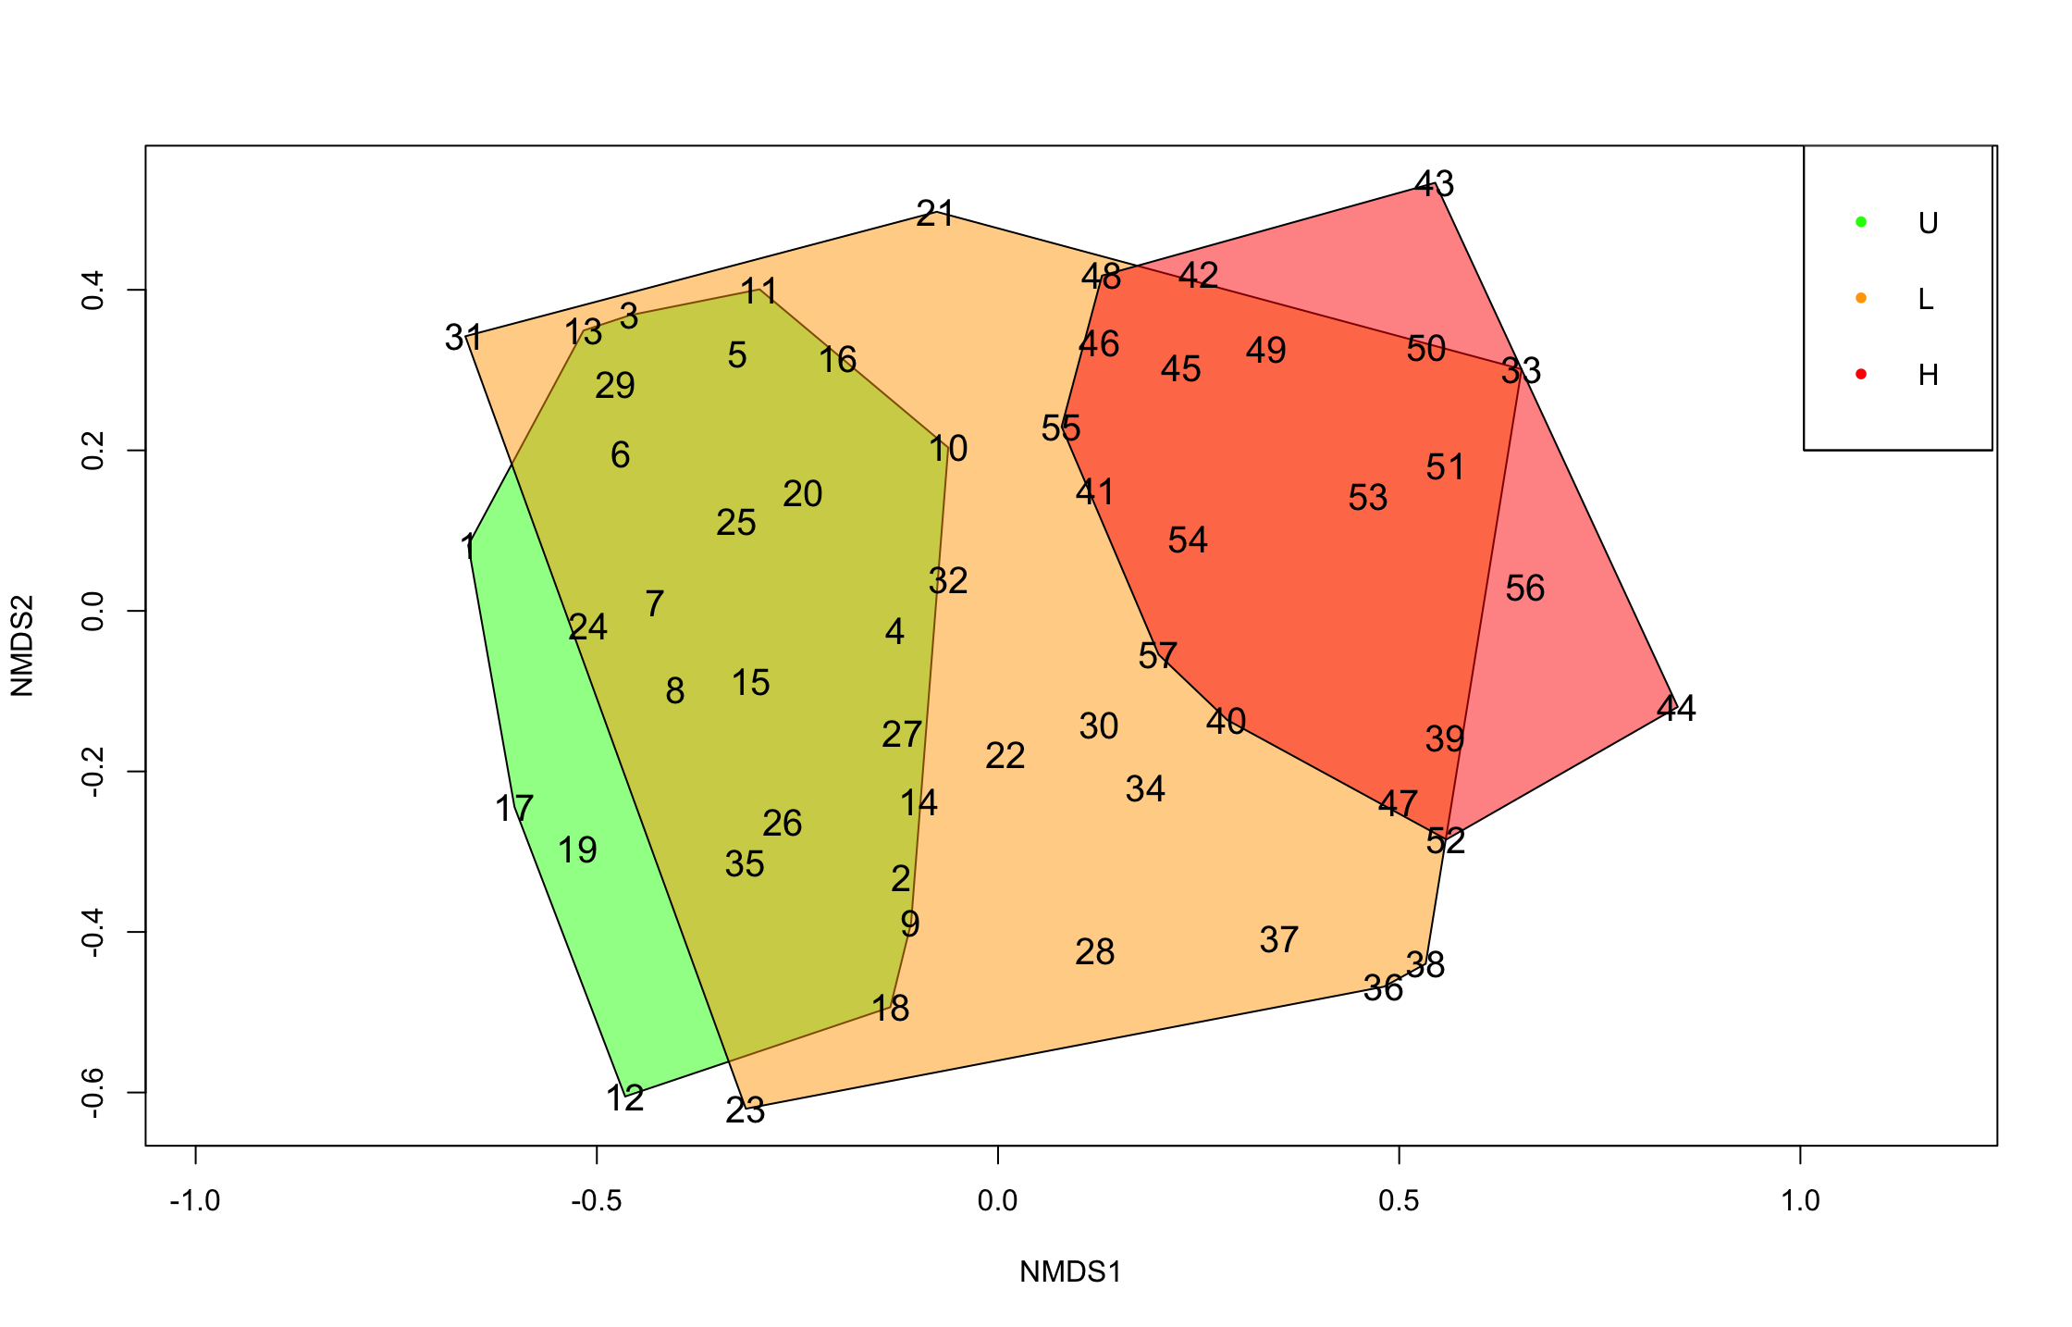
Museum Fire site community matrix
57 plots x 42 species
Good source explaining NMDS: Starting with Non-Metric Multidimensional Scaling (NMDS) from University of Virginia Library
Notes:
I’m going to demonstrate these methods with some data from a mixed-severity fire up in Flagstaff, Arizona collected by my lab-mates that we have been using to assess how this ecosystem is responding to these differences in post-fire conditions. We have our community matrix on the left with those plot rows and species columns, and on the right we have a nonmetric multidimensional scaling or NMDS of these data, and plots have been colored by their wildfire severity. The ellipses are essentially a 95% confidence interval around the centroids of these communities within this 2d ordination space. The arrows with those labels are an additional way to look at differences in communities, such that plots further along the resprouting vector from the origin had more species with the ability to resprout after the fire, and plots further along the height vector tended to have species that grew taller.

Slide 8
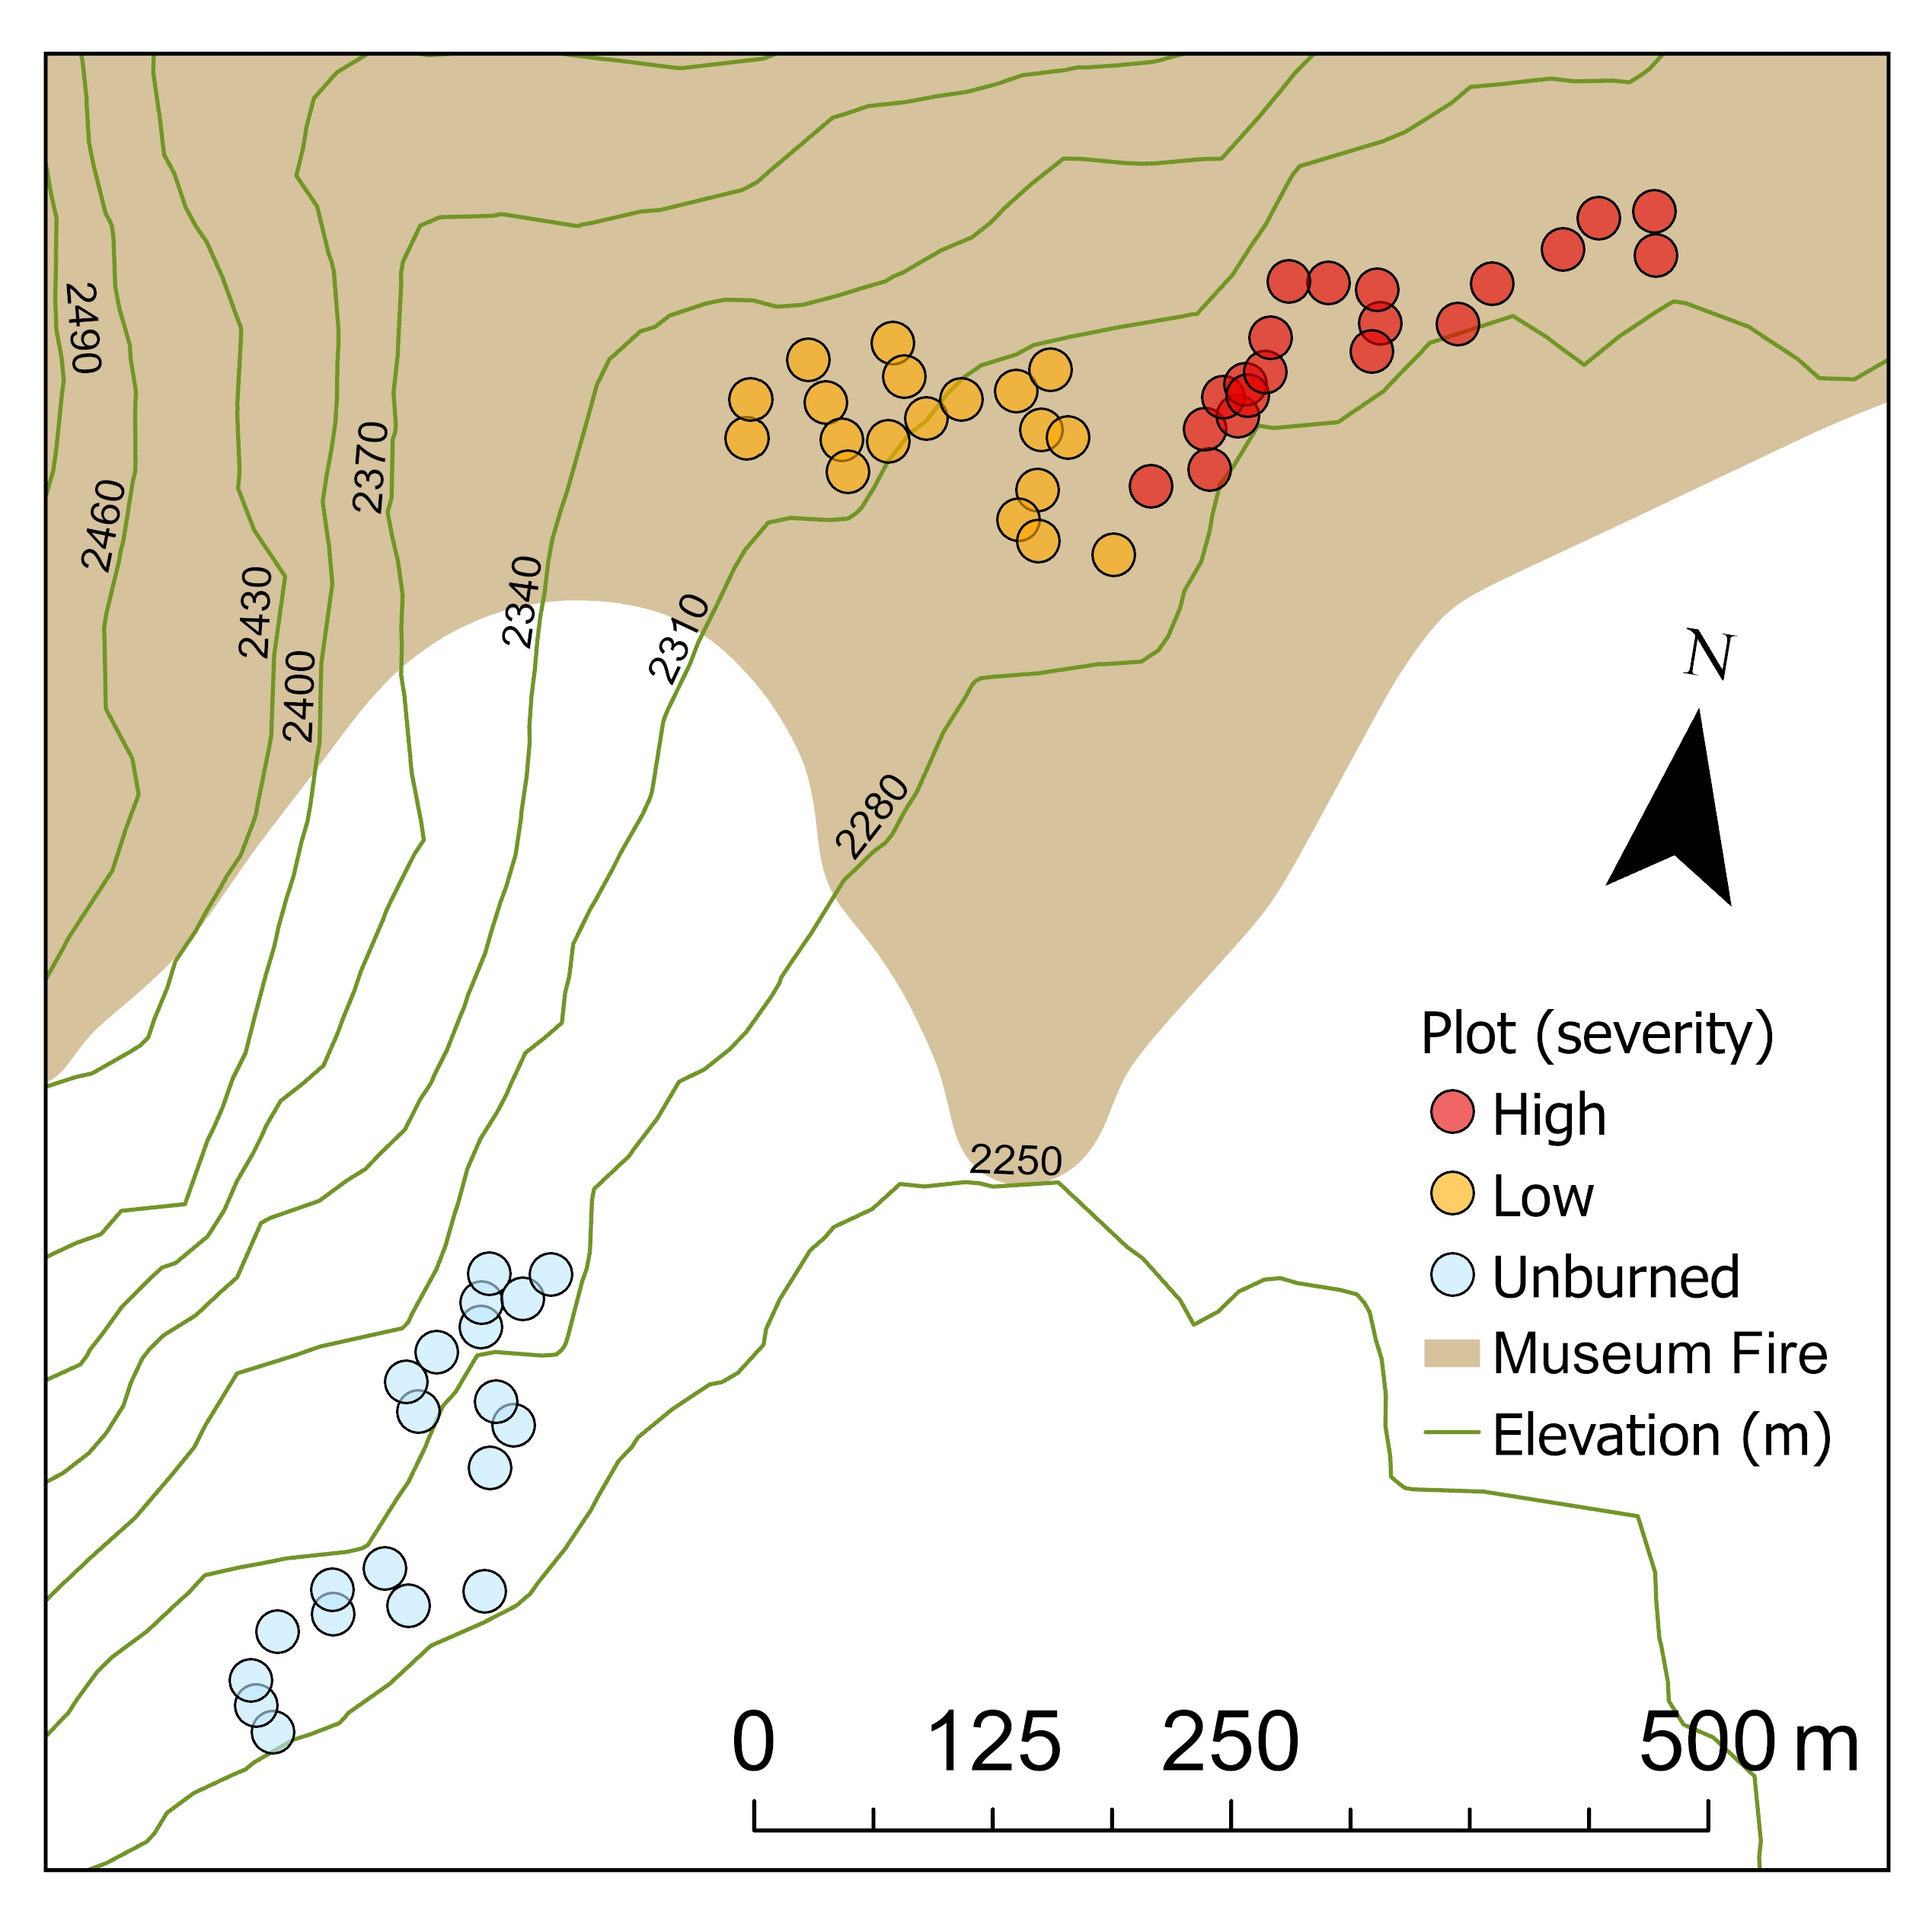
Why do we care about spatial structure in plant communities?
These data are collected in a geographic context
Plant communities respond to spatially varying attributes of the environment
The secret reason: reviewers always ask “what about spatial autocorrelation???”
Notes:
Ok so that’s cool but what about spatial dependence? Here we have a map of the study area, and we can see that all of these plots are pretty close together. This was part of constraining the variability in topography when deciding on the plot locations, so it’s worth considering in our analysis to see if that could influence the inferences that we make about how fire severity- or a lack of fire altogether- altered the plant community.
Plant community are inherently spatial, and in ecology, we rely on environmental gradients to assess what drives differences in communities. So spatial dependence is immediately a factor of interest.
There is a nice, seemingly growing body of literature around multivariate methods that consider spatial dependence specifically targeted at plant ecologists, so maybe we’ll get the memo one day.
https://pachterlab.github.io/voyager/articles/multispati_landing.html

Slide 9
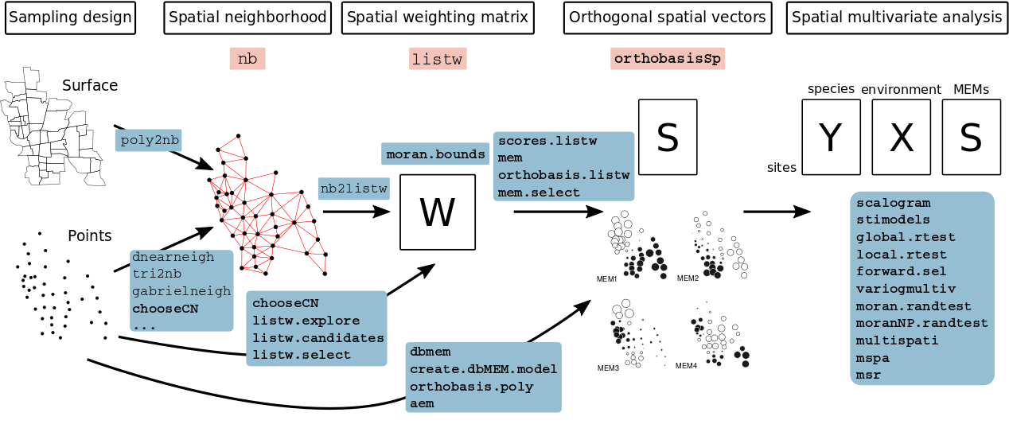
R package adespatial
Dray S, Bauman D, Blanchet G, Borcard D, Clappe S, Guénard G, Jombart T, Larocque G, Legendre P, Madi N, Wagner HH (2025). adespatial: Multivariate Multiscale Spatial Analysis. R package version 0.3-28.

Slide 10
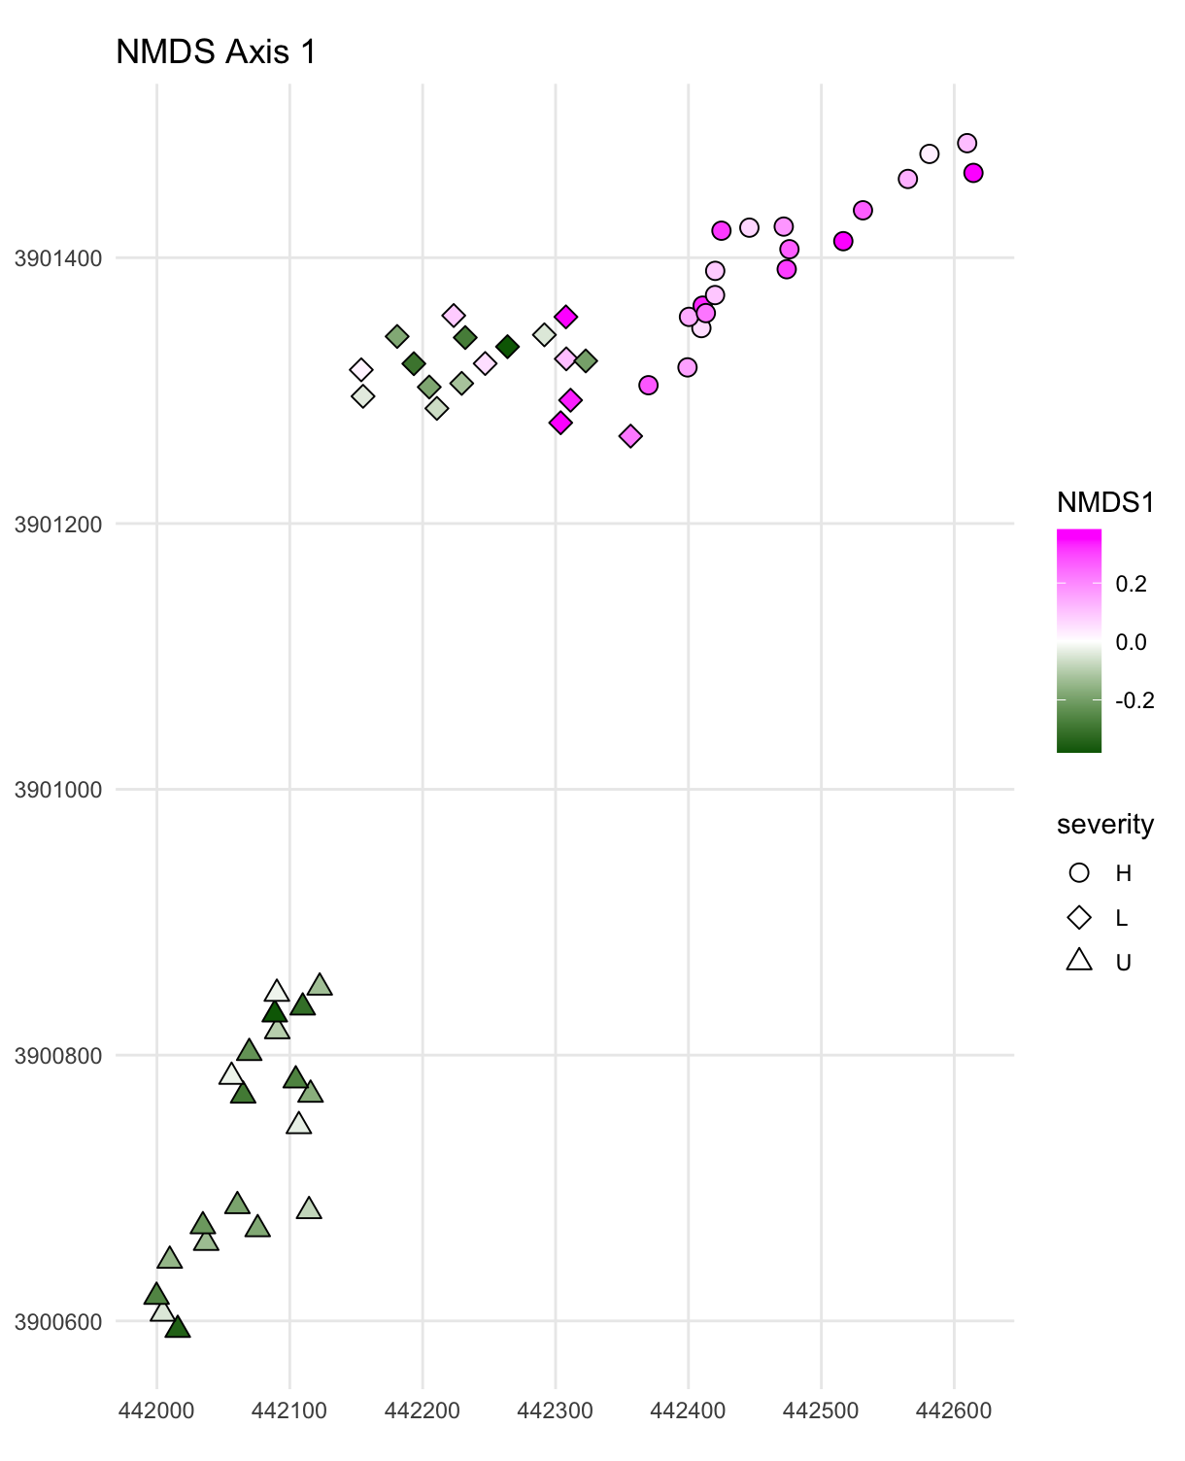
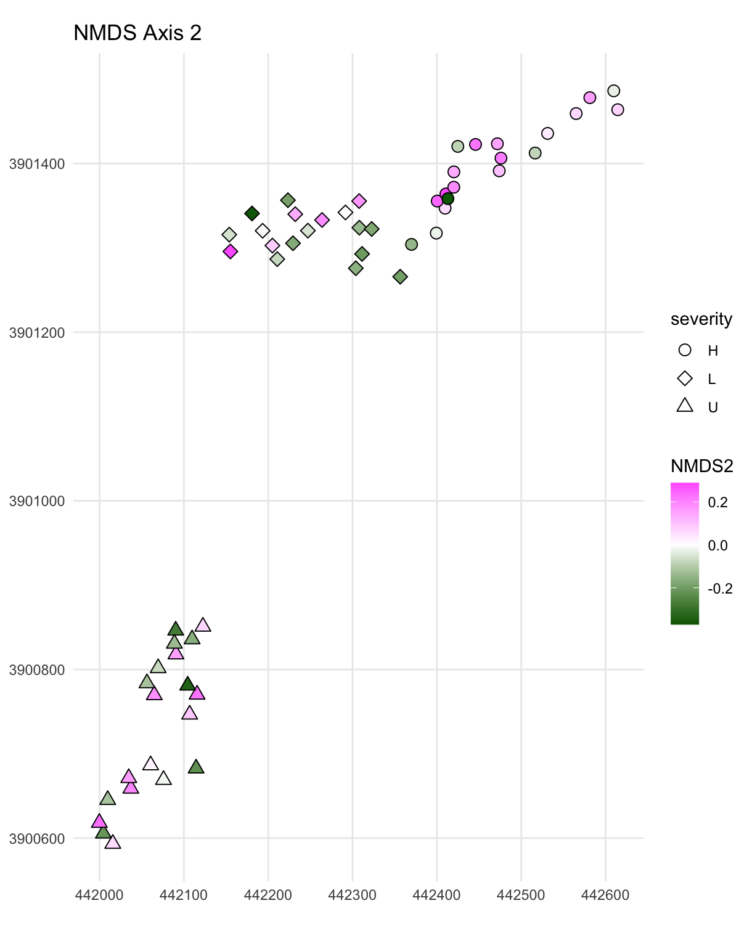
100 meters
Notes:
Replace plots with shape by severity

Slide 11
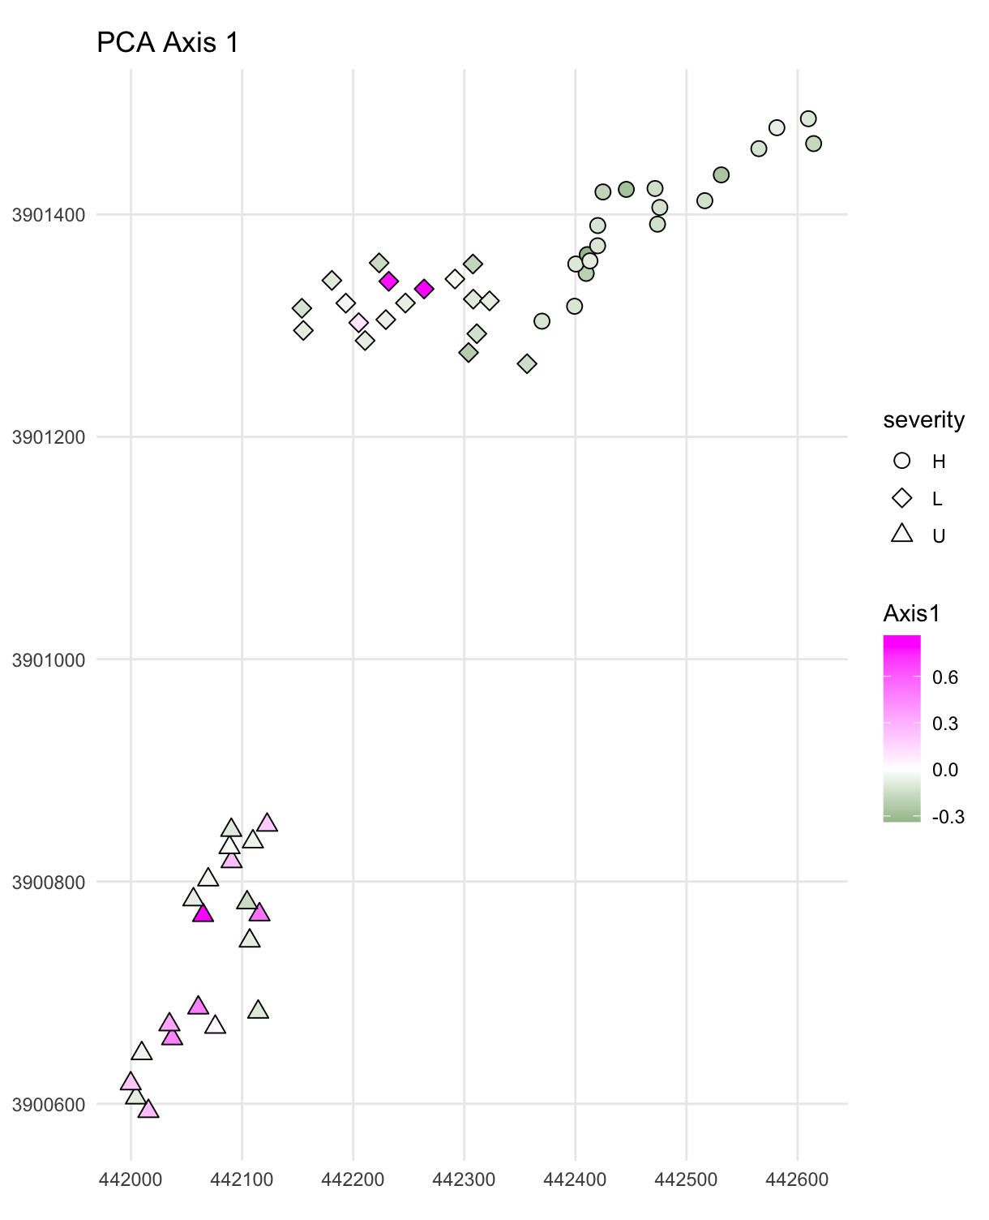
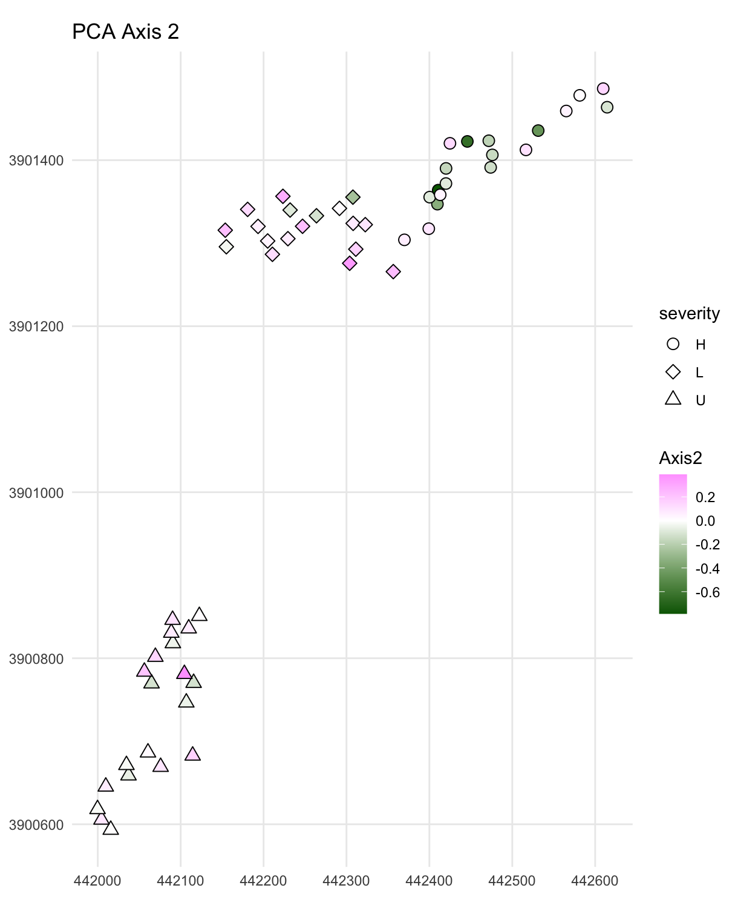
100 meters
Notes:
Replace plots with shape by severity

Slide 12
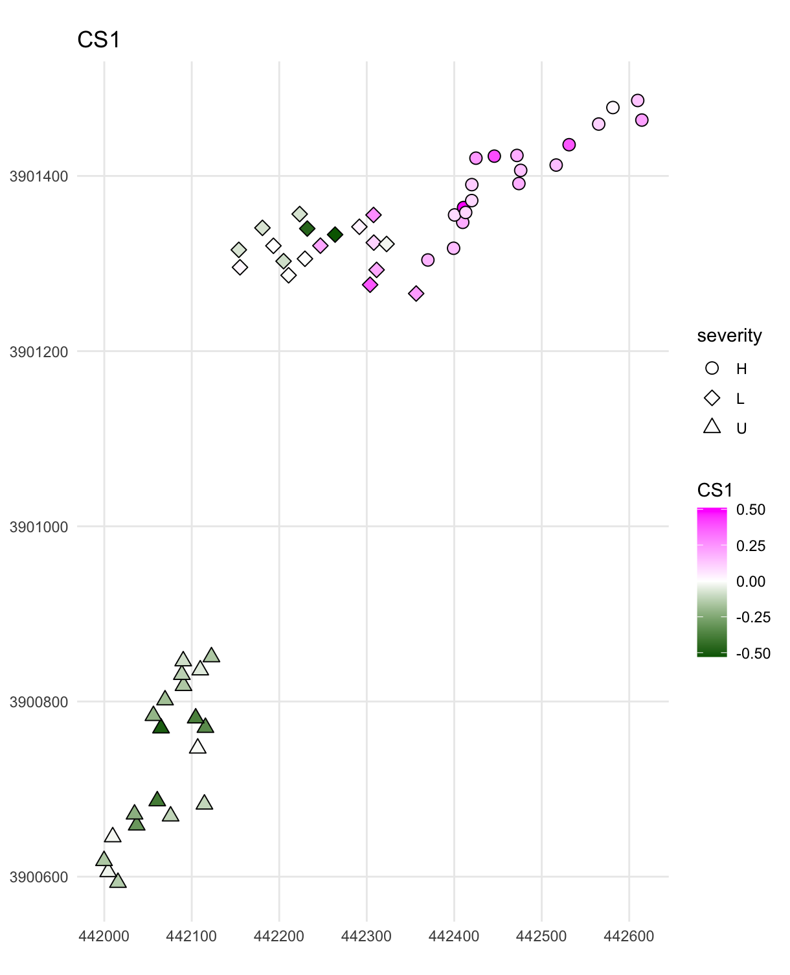
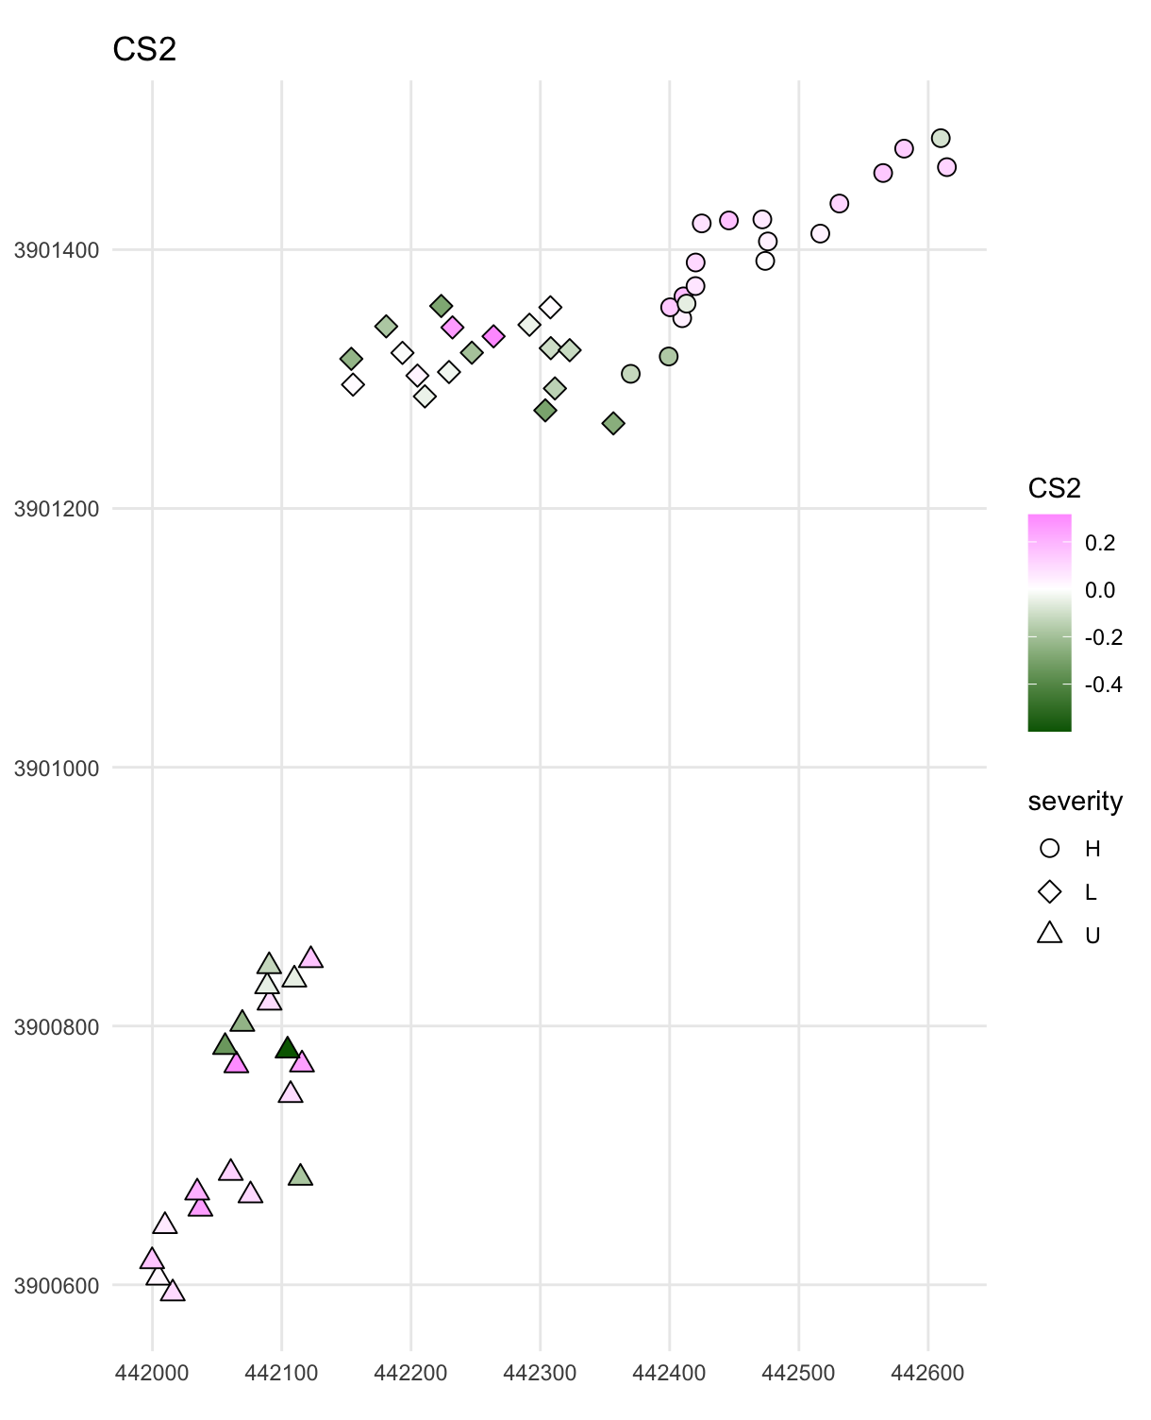
MULTISPATI: PCA & neighborhoods
Wartenberg 1985 Geographic Analysis; Dray, Saïd, and Débias 2008, J. Veg. Sci.
100 meters
Notes:
Product of Moran’s I and PC eigenvalues?
Looks for autocorrelation in PC scores
These scores don’t just maximize variance explained but maximize variance explained times Moran’s I
Improved upon by https://onlinelibrary.wiley.com/doi/abs/10.3170/2007-8-18312

Slide 13
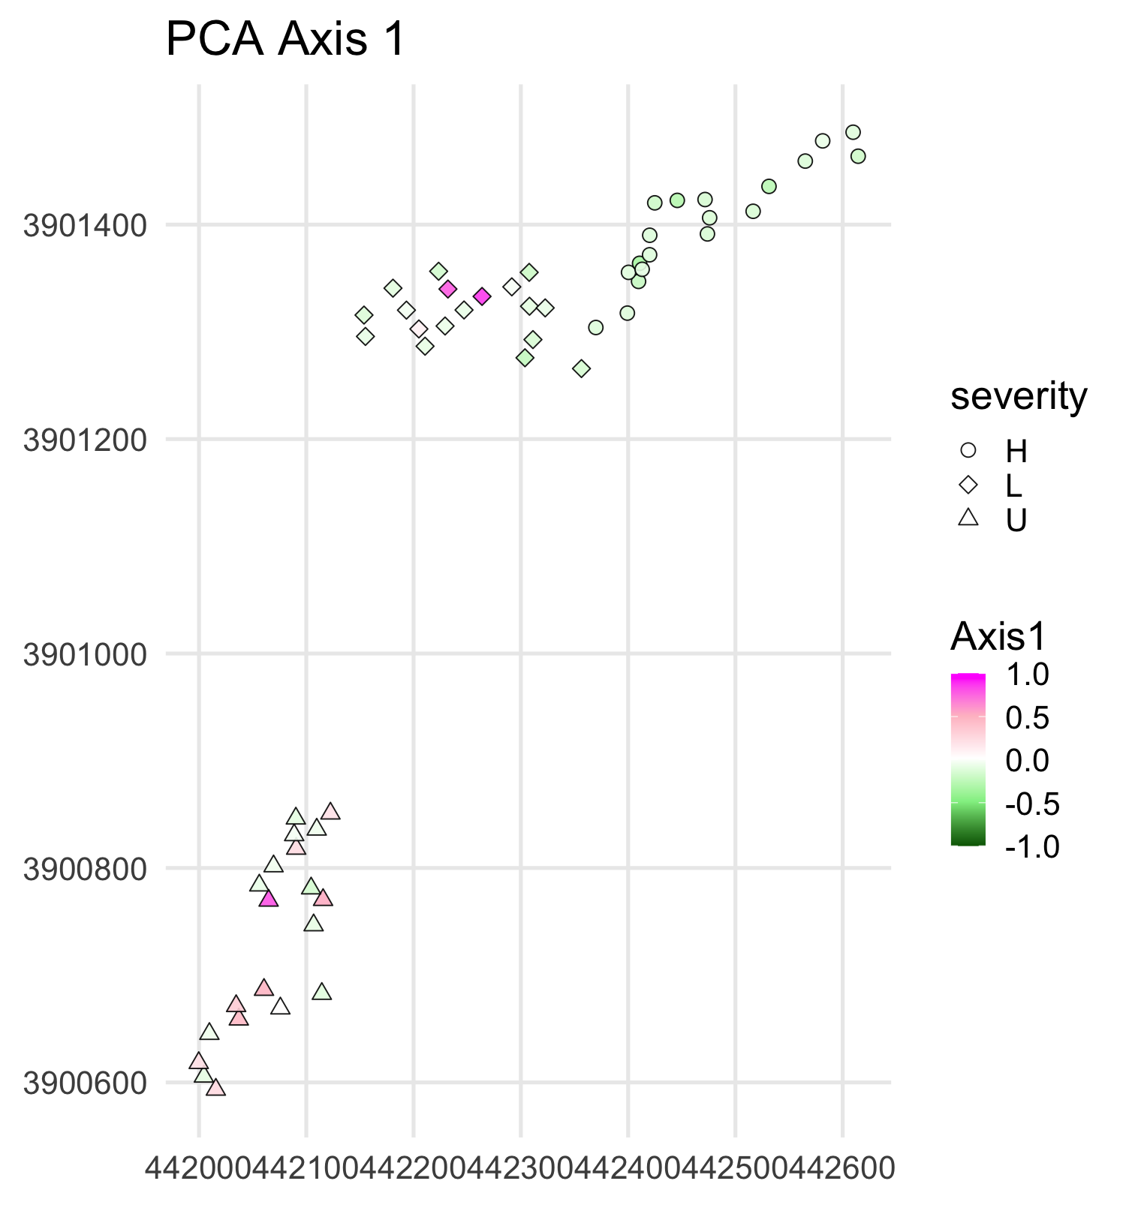
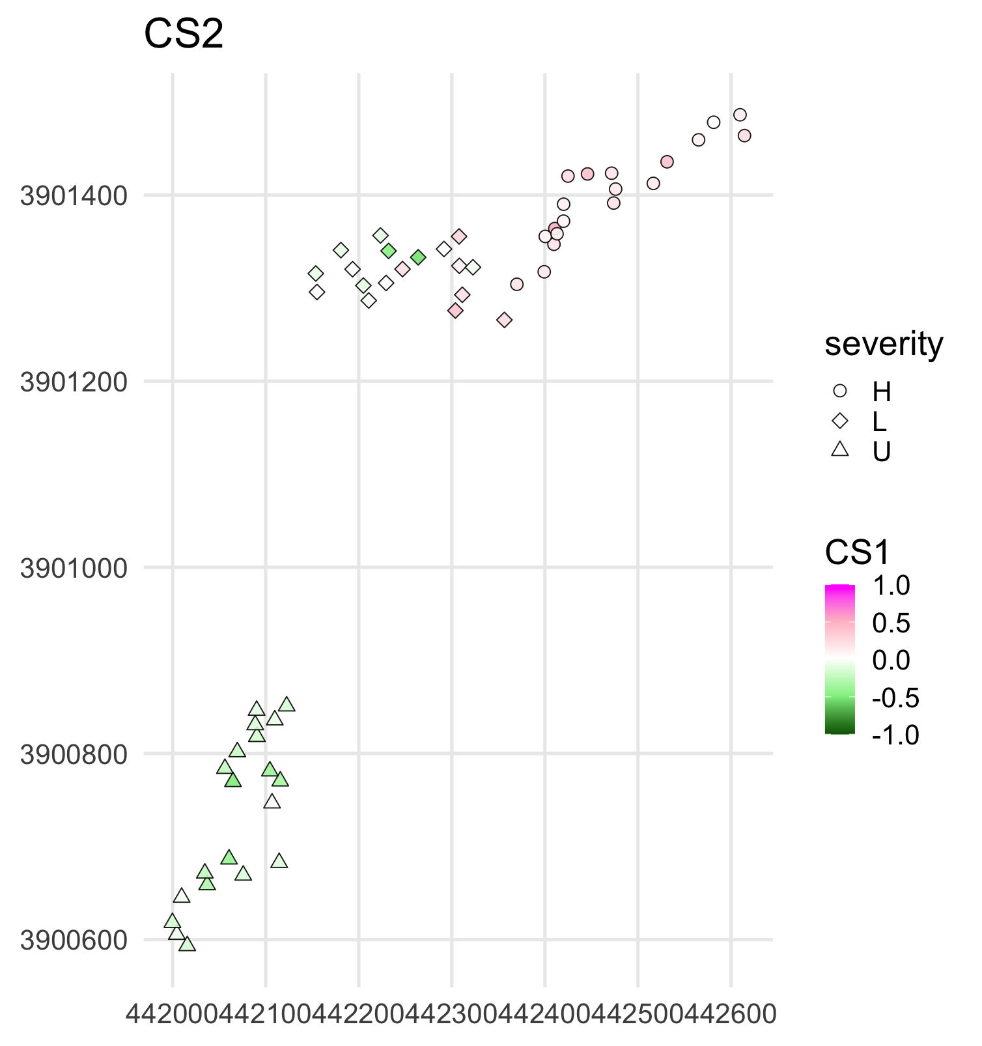
Comparing axis 1 scores: PCA vs MULTISPATI
(MULTISPATI-PCA)
100 meters

Slide 14
Cool stuff
Co-kriging can take advantage of both spatial dependence and relationships between variables
Methods for collocated vs. non-collocated MVD
Improve species distribution modeling
Zero inflation methods
Geostatistical/point process approaches
ZVH 12.4.1, 12.4.5
Gelfand 2022, Spatial Statistics
Dray, Saïd, and Débias 2008, J. Veg. Sci.
Miller, Franklin, and Aspinall 2007, Ecological Modelling
Notes:
https://www.sciencedirect.com/science/article/pii/S2211675321000786#sec3

Slide 15
Limitations
End results of ordination-based analyses can be hard to interpret without further univariate exploration
Neighborhood definitions can affect identification of spatial patterns and clusters
Either have to assume that all response variables have the same spatial structure/smoothness or specify separately
Vaughan and Ormerod 2005, Journal of Applied Ecology
Parsons, Cooper, and Albertson 2009, PLOS One
Uyeda, Caetano, and Pennell 2015, Systematic Biology
Nelson and Boots 2008, Ecography
Apanasovich et al. 2012, J. Am. Stat. Soc.
ZVH 12.4.5
Notes:
You lose so much information with dimension reduction that you can look at how things are clustered but you don’t necessarily know what is clustering or what species in the community are driving dependence (https://besjournals.onlinelibrary.wiley.com/doi/full/10.1111/j.1365-2664.2005.01038.x).
PCA is most efficient in multivariate scenarios where dimensions are correlated (https://journals.plos.org/plosone/article?id=10.1371/journal.pone.0007957), but if you have high effective dimensionality (where lots of dimensions are independent), then inference can be erroneous (https://academic.oup.com/sysbio/article-abstract/64/4/677/1649888).
“Without knowing a priori whether axes of variation among distinct groups are similar, it is impossible to know the degree to which an ordered axis plots approach will yield misleading results.” (from same plosone paper above)
So when using PCA in looking at differences between groups, you can get misleading results where there may be different PCs among the groups/treatments
So with my fire severity data, we have evidence that the species composition differed between the groups, and our PCA approach may not appreciate this variation. I didn’t have time to explore how this would affect results, but it’s something worth considering if you’re doing a similar analysis.
Neighborhood definitions (https://nsojournals.onlinelibrary.wiley.com/doi/epdf/10.1111/j.0906-7590.2008.05548.x)- this isn’t a limitation unique to multivariate cases, but it’s a hard choice to make
There have been developments in methods that address these latter two points, such as the flexible matern model proposed in Apanasovich et al. 2012 (https://www.jstor.org/stable/23239660?seq=1)

Slide 16


